Slide 1
West Niles Virus Prediction Report

Slide 2
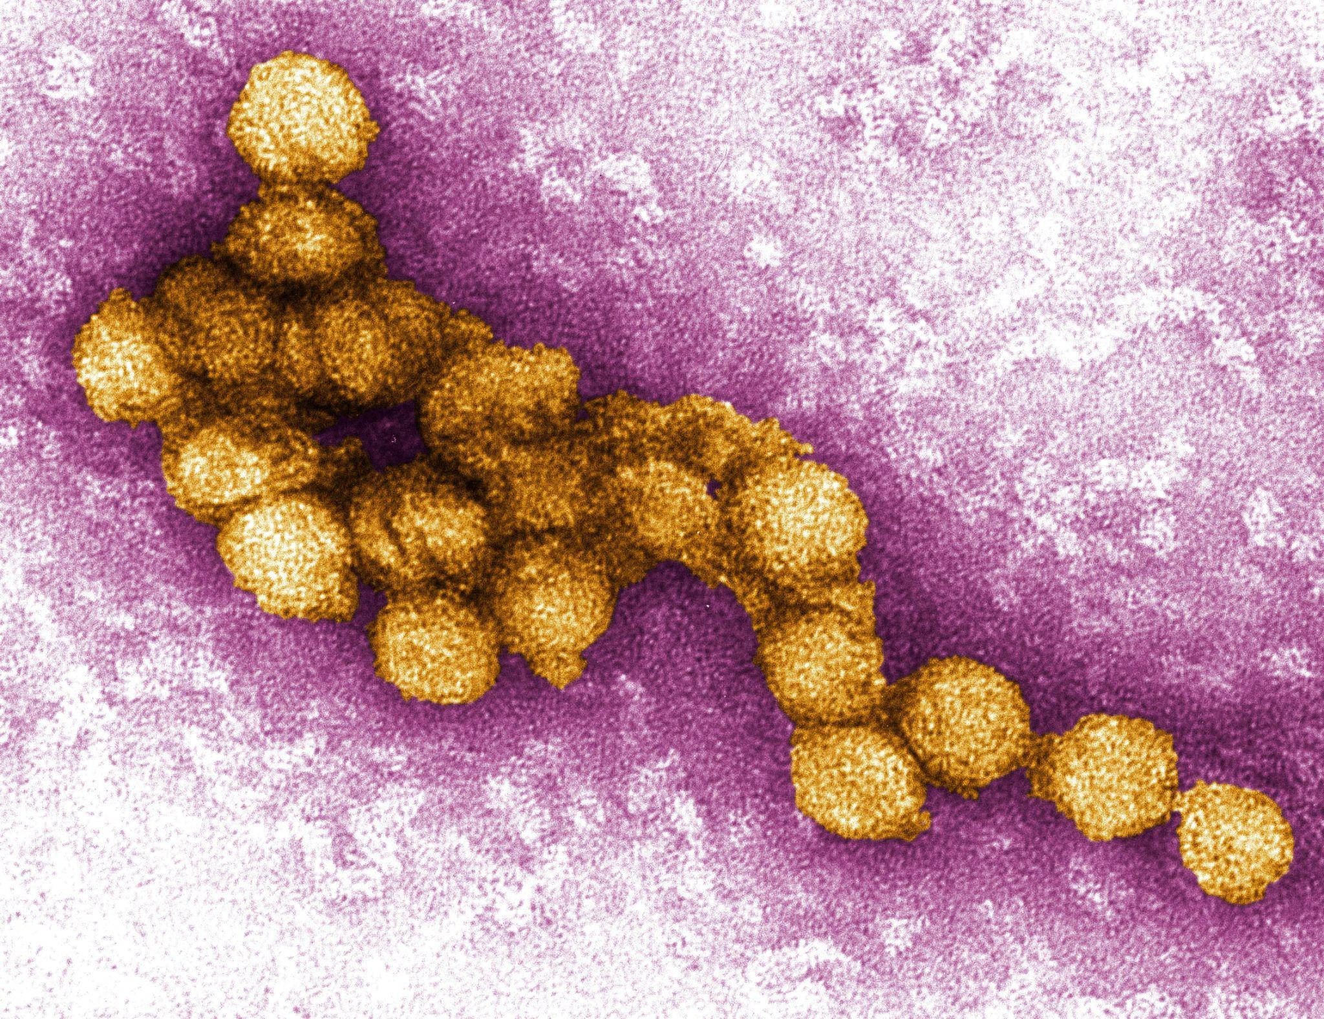
Problem Statement
The West Niles Virus(WNV) is the leading cause of mosquito-borne disease in US.
In this project we use machine learning techniques to analyze mosquito testing data in Chicago.
Our goal: predict the presence of the virus; find the most important factors that contribute to the presence of the virus.

Slide 3
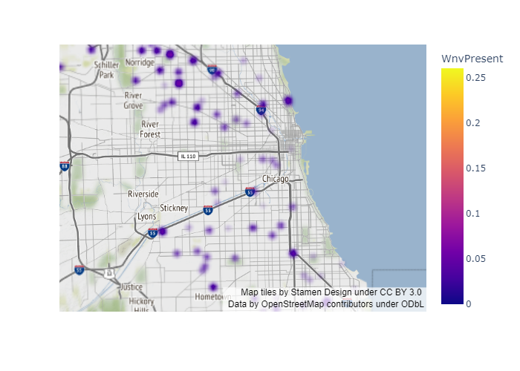
Locations in Chicago with WNV presence

Slide 4

Data Source
Testing data for WNV from Kaggle.
Chicago weather data from Kaggle.
Chicago Census data from Chicago city government websites.

Slide 5
Data Wrangling
Transform weather data into correct datatype.
Fill in missing values for weather data
Generate one-hot encoding for special weather phenomenon
Add demographical data from Internet source
Combine weather data with mosquito testing data

Slide 6
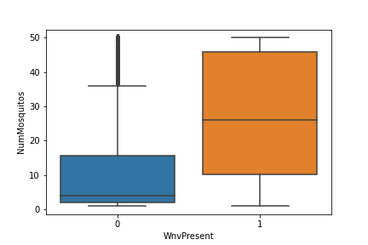
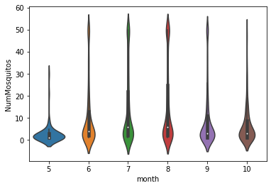
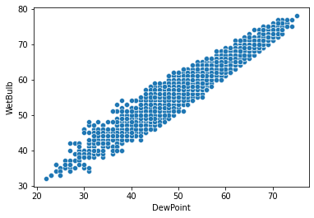
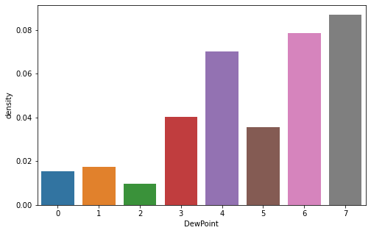
EDA

Slide 7
Feature generation and selection
Generated lag features for weather.
EDA reveals severe feature multicolinearity.
Select feature using information value.
Reduce multicolinearity using VIF.

Slide 8
Modelling
Undersampling to deal with unbalanced dataset
Look for models to maximize AUC
Shap analysis to determine feature influence on model prediction.
Grid search to find optimal hyperparameters

Slide 9
Model comparison
Model | AUC on Test | AUC on Train
Random Forest | 0.84 | 0.92
Lightgbm | 0.84 | 0.96
Xgboost | 0.82 | 0.99
Logistic Regression | 0.80 | 0.83
SVM | 0.81 | 0.95

Slide 10
Winning Model
Based on AUC score on training and testing set, random forest model is the winning model. Here’s the confusion matrix:
class | 0 | 1
0 | 0.875 | 0.470
1 | 0.125 | 0.529

Slide 11
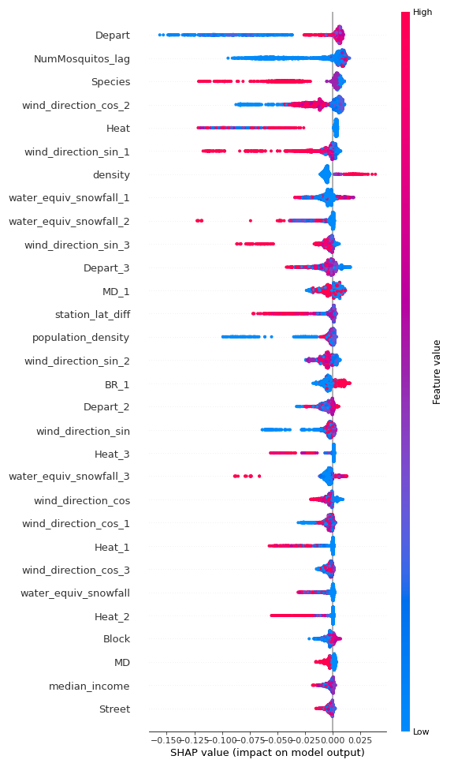
Shap analysis

Slide 12
Our Findings
If the humidity is relatively high in the past few days, then the virus is more likely to be present.
If there are east winds in the past few days, then the virus is more likely to be present.
When temperature is high, the virus is more likely to be present
If there was mist yesterday, then the virus is more likely to be present.
WNV is more likely to present in the CULEX PIPIENS/RESTUANS species

Slide 13

Recommendations to Chicago City Council
Increase test frequency when temperature is high
Increase test frequency when humidity is high
Increase test frequency when east wind prevails
Keep testing frequency until the number of mosquitos caught in the traps start to show a decreasing trend.

